Slide 1


Optics Laboratory
2nd Grade - 1st Semester
2018/2019
Instructors
Assist. Prof. Dr. Sabah Ibrahim
Assist. Lect. Muhanned Jamal
Assist. Lect. Najwa Ibrahim

Slide 2
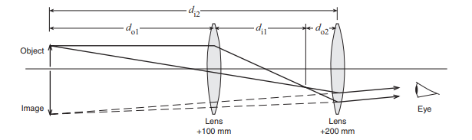
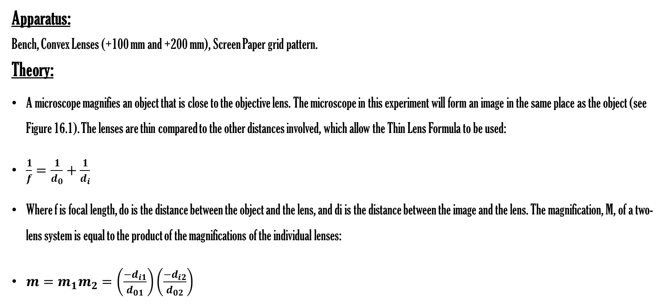
Experiment Nine
Microscope
Apparatus:
Bench, Convex Lenses (+100 mm and +200 mm), Screen Paper grid pattern.
Theory:
A microscope magnifies an object that is close to the objective lens. The microscope in this experiment will form an image in the same place as the object (see Figure 16.1). The lenses are thin compared to the other distances involved, which allow the Thin Lens Formula to be used:
$\frac{1}{f}=\frac{1}{d_{0}}+\frac{1}{d_{i}}$
Where f is focal length, do is the distance between the object and the lens, and di is the distance between the image and the lens. The magnification, M, of a two-lens system is equal to the product of the magnifications of the individual lenses:
$m=m_{1}m_{2}=\left(\frac{−d_{i1}}{d_{01}}\right)\left(\frac{−d_{i2}}{d_{02}}\right)$

